Slide 1
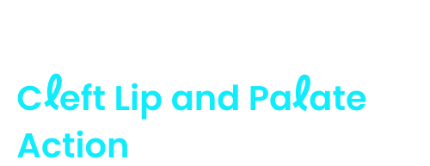

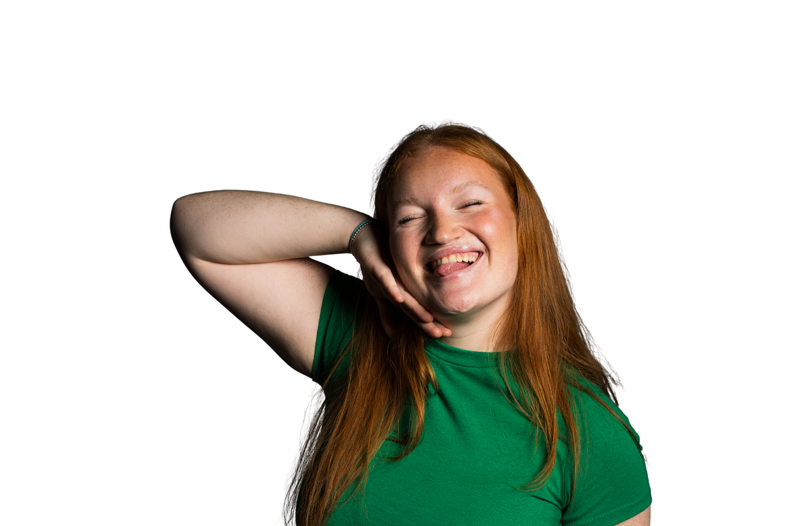

About us
Registered Charity England & Wales (1108160) and Scotland (SC041034)

Slide 2
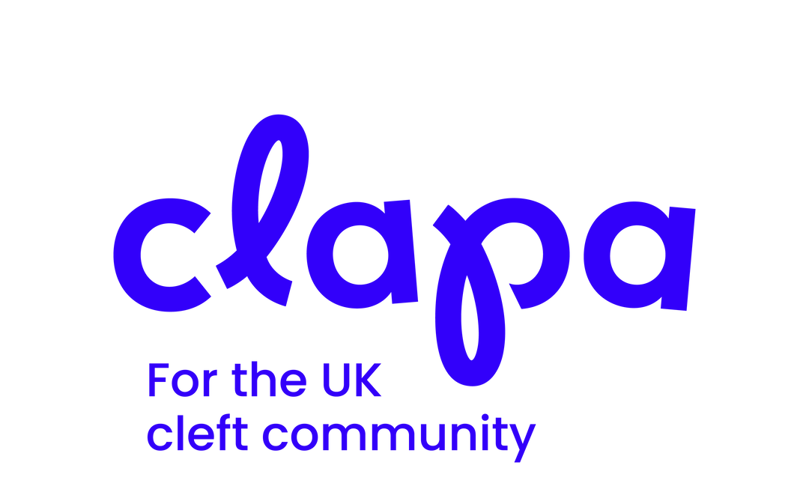
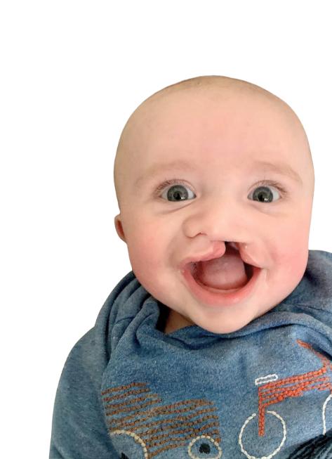
What is a cleft?
  In early pregnancy, parts of the face form separately and then join in the middle​
  For one in 700 babies, this doesn’t happen as it should​
  A cleft lip is one or two gaps in the upper lip
  A cleft palate is a gap in the roof of the mouth​
  A baby can have a cleft lip, cleft palate, or both together​
  It’s usually caused by a complicated mix of genetic and environmental factors

Slide 3
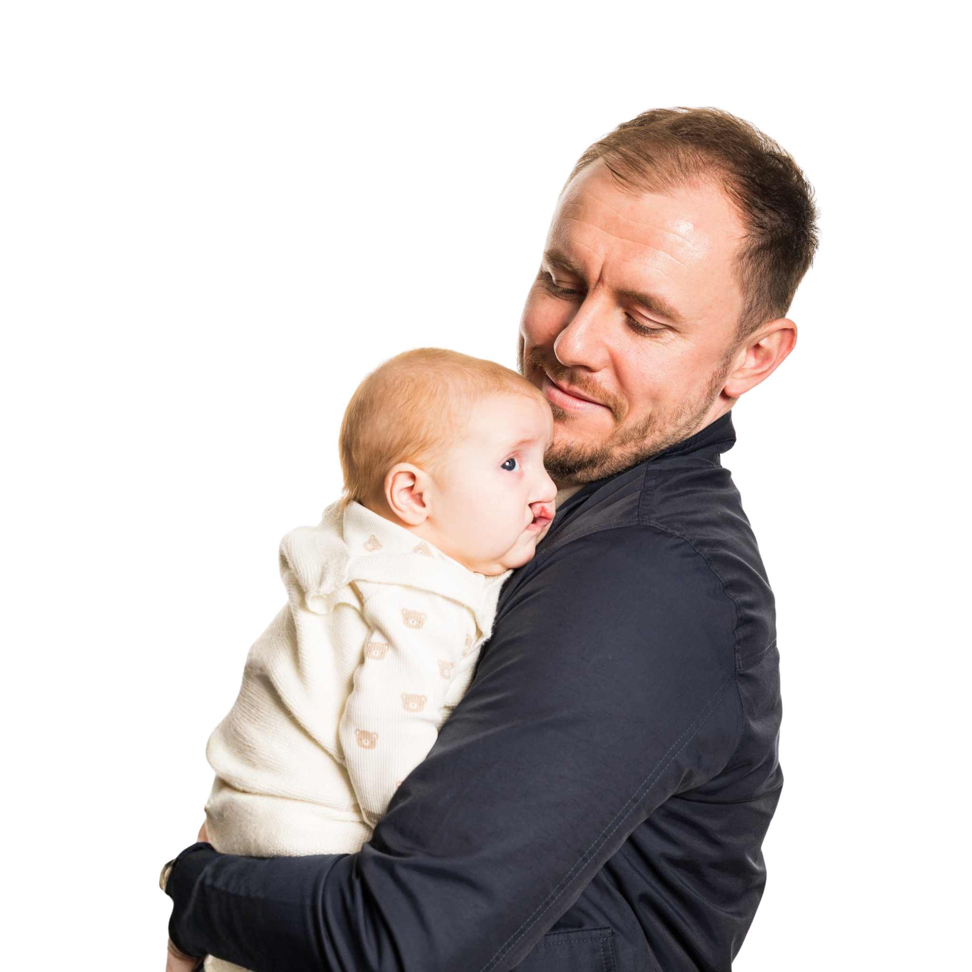
What is the impact?
  Feeding: Most babies need to use special bottles and teats from CLAPA to feed​
  Hearing: Many children with a cleft palate have recurring hearing issues
  Speaking: A cleft palate affects how certain sounds are made
  Teeth: A cleft can affect the shape and position of teeth and make dental care more difficult
  Appearance: Visible scars can affect confidence and self-esteem

Slide 4
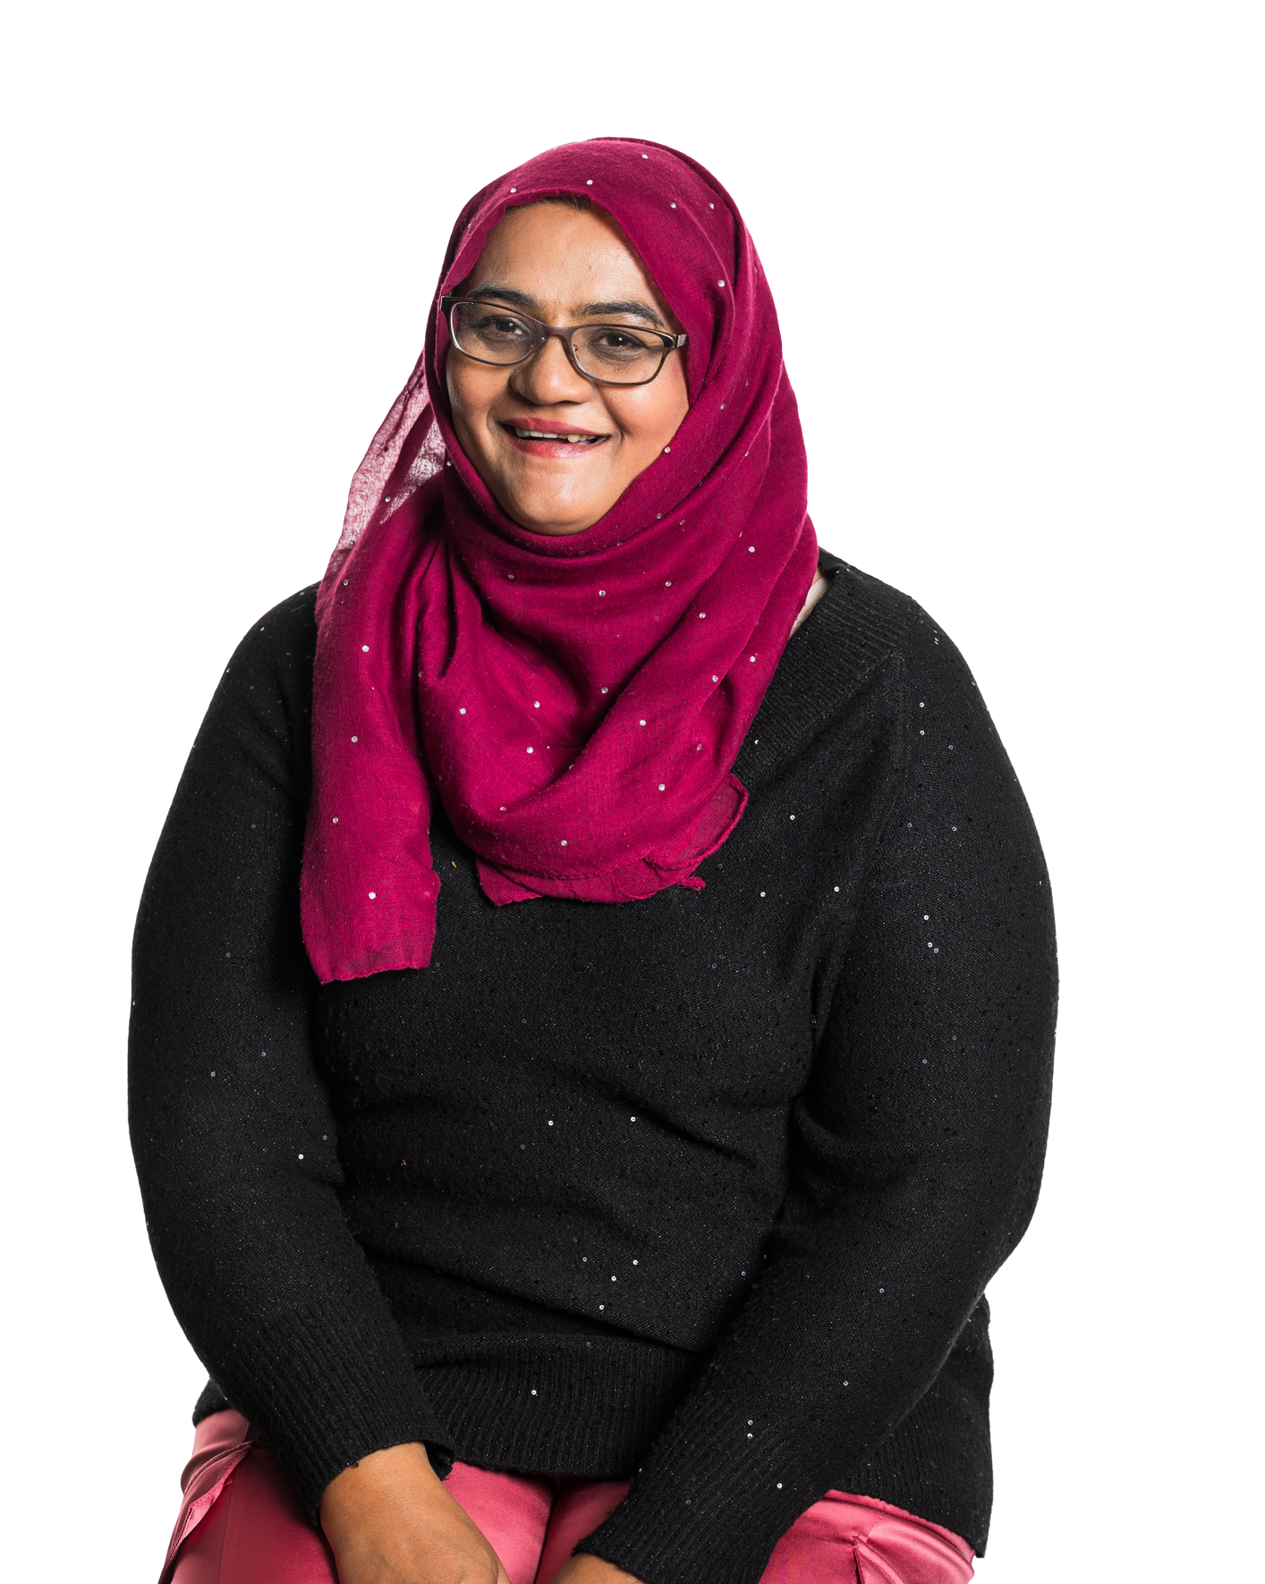
Cleft myth 1:
Cleft is 'fixed' with surgery as a baby
Notes:
Lets bust some myths….

Slide 5
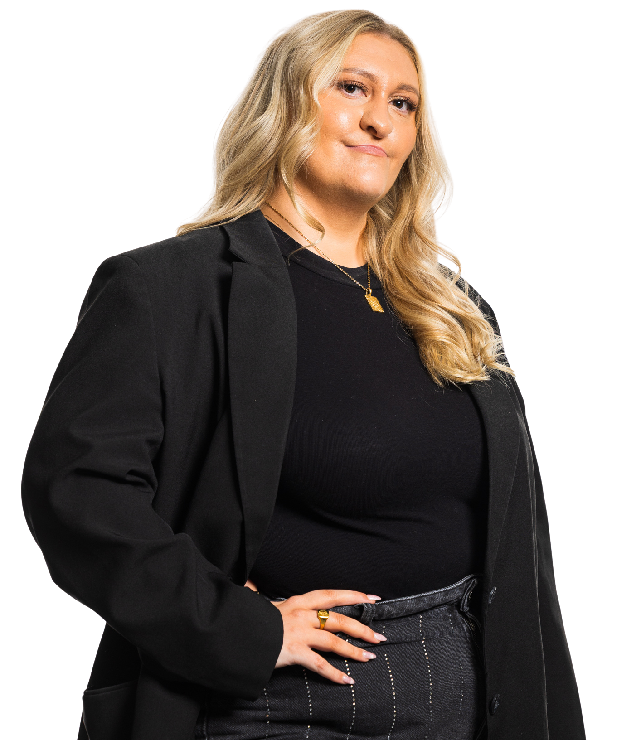
Fact: the cleft treatment pathway
is 20+ years
  Every cleft is unique, just like every child, so the exact treatment needed will vary. Treatment can include:
  Operations: babies born with a cleft will need at least one operation to repair their cleft and may need more as they grow up to help with things like teeth, speech, breathing.
  Speech therapy: around 50% of children born with a cleft palate need extra help to make certain sounds clearly
  Help with hearing: many children born with a cleft
  palate need grommets or hearing aids
  Dental and orthodontic work: braces, surgical
  treatment, and other interventions are often needed
  Psychological support: support from cleft-specialist Clinical Psychologists
Notes:
Operations:
babies born with a cleft will need at least one operation to repair their cleft, and may need more operations as they grow up
Speech therapy:
children born with a cleft palate in particular will have their speech regularly assessed, and speech and language therapy will be offered if needed
Help with hearing:
children born with a cleft palate will have their hearing regularly assessed and treatment offered as necessary
Dental and orthodontic work: if a cleft affects the gums and teeth, extra support and treatment may be needed, such as braces, restorative dentistry, or surgical treatment
Psychological support: support from cleft-specialist Clinical Psychologists is available to people born with a cleft and their families throughout the entire treatment pathway
x
x
x

Slide 6
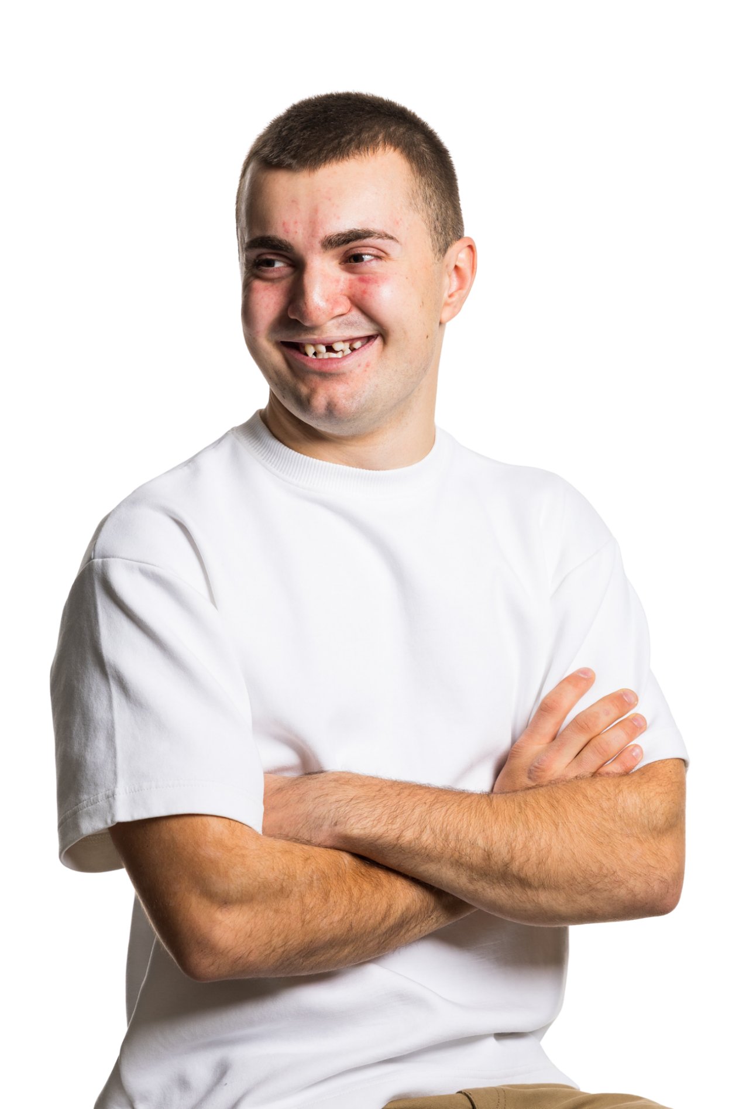
Cleft myth 2:
Cleft doesn't happen in the UK, does it?

Slide 7
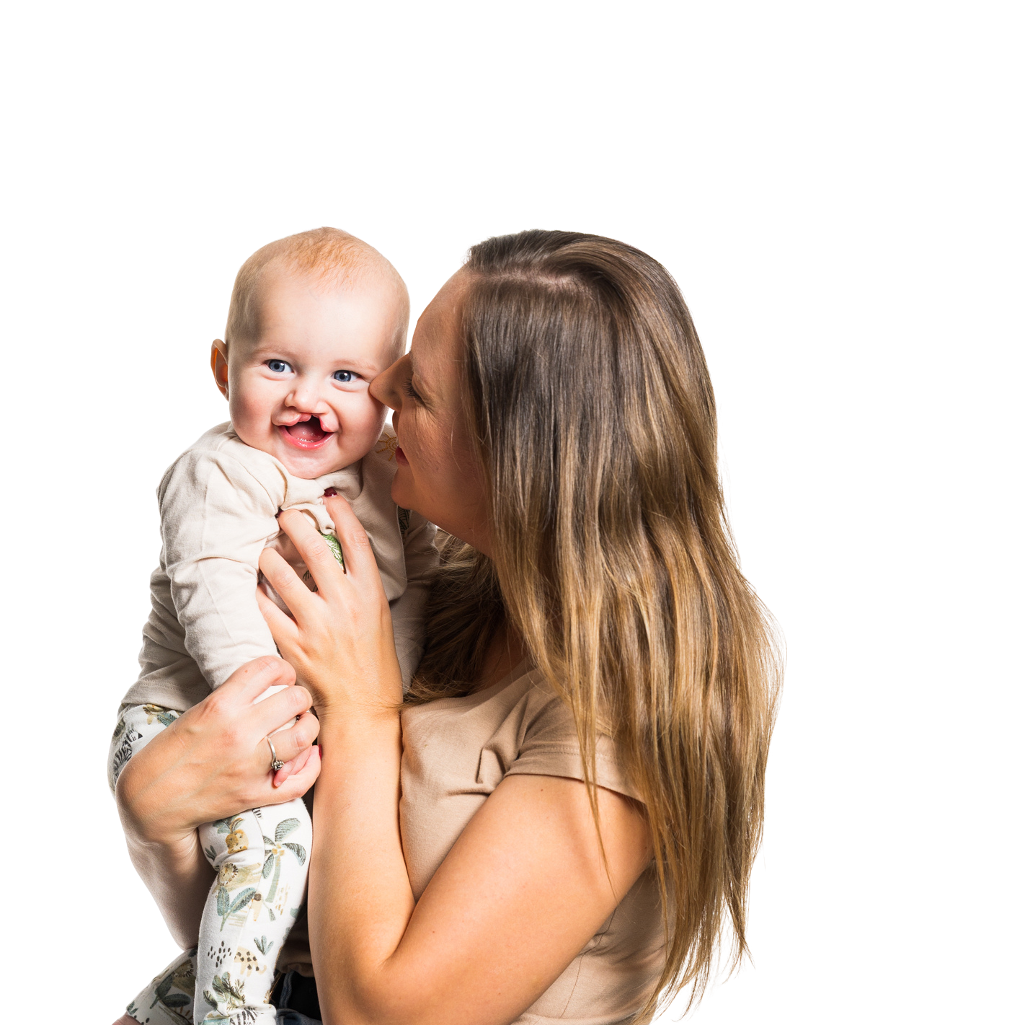
Fact: cleft occurs in one in 700 births
  On average, three babies are born with a Cleft in the UK
  each day

Slide 8
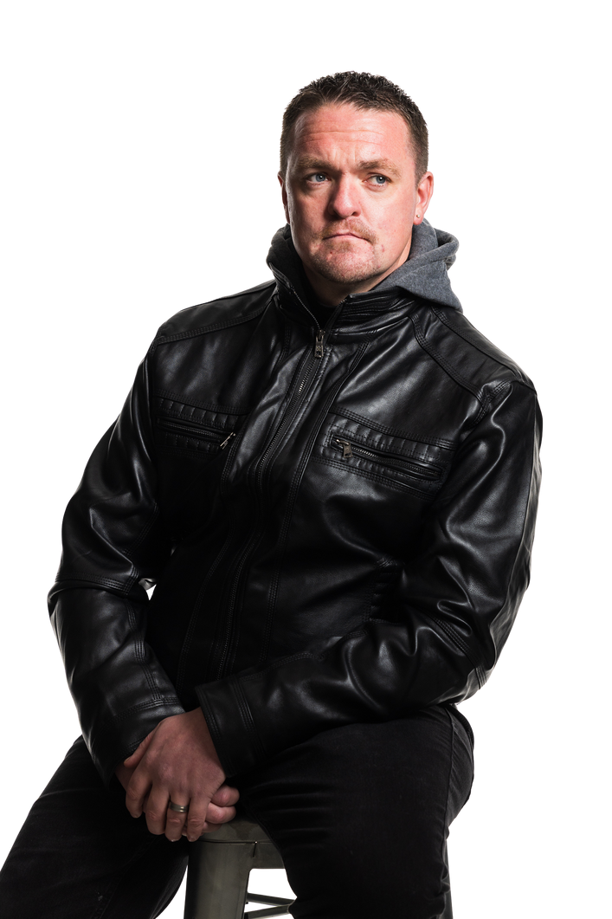
What is CLAPA?
  Cleft Lip and Palate Action (CLAPA) are the national charity supporting, connecting, celebrating and championing the UK cleft community.
  CLAPA is there from the moment of diagnosis and throughout a lifetime with cleft, so nobody has to go through their cleft journey alone.
  We receive no NHS or government funding and we rely on donations to continue our vital work.

Slide 9

CLAPA’s Services
  Specialist feeding bottles
  One-to-one support
  Online support groups and events
  Supporting research
  Children and young people's service
  Adult services
  Information service
  Raising awareness and campaigning
Notes:
CLAPA’s Work – Presentation Notes
Specialist Feeding Bottles
Babies born with a cleft often struggle to feed from the breast or a standard bottle due to difficulty forming suction.
CLAPA is the only UK supplier of specialist bottles/teats recommended by NHS Cleft Nurse Specialists.
We distribute 10,000+ items each year to families and NHS Trusts.
Every new family receives a free Welcome Pack with bottles, teats, and information.
We also supply free items to families in financial need.
Our stock:
~50% manufactured with MAM – soft‑squeeze bottles allowing carers to help milk flow.
~50% imported with Dr Brown’s Medical – bottles with special valves allowing milk flow without suction.
One‑to‑One Support
Cleft journeys can be emotional, from diagnosis through adulthood.
CLAPA has trained Parent and Peer Supporters offering support via phone or email.
Provides a confidential, non‑judgemental space for those experiencing acute worries.
Around 100 people a year use this service.
90% report feeling less isolated, more confident, and better able to cope.
Online Support Groups & Events
We connect people affected by cleft across the UK.
Social media shares positive stories, challenges myths, and celebrates differences.
Moderated online groups give instant access to peer support.
Regular online events discuss key topics (e.g. surgery, feeding, talking about cleft).
Skills workshops (e.g. Baby Signing) run by volunteers with lived experience.
94% of attendees feel more equipped to handle cleft‑related challenges.
Supporting Research
We help make cleft research accessible and inclusive for everyone.
Work with researchers to ensure patients and families are involved from all backgrounds.
Run consultation groups, live Q&As, and publish lay summaries.
Participants often describe feeling heard, valued, and empowered.
Children & Young People’s Services
Peer connections help young people build confidence and self‑esteem.
Cleft++ mentoring: safe online platform connecting 12–17‑year‑olds to trained young adult mentors with lived experience.
Children and Young People’s Council (CYPC): 9–17‑year‑olds advising CLAPA, NHS teams, and researchers.
CYPC helps create youth‑friendly resources, videos, and leaflets.
Annual Cleft Youth Magazine for ages 6–12.
Adult Services
Around 90,000 adults in the UK were born with a cleft.
Many don’t know they can access NHS specialist treatment into adulthood.
CLAPA develops research‑driven information to help adults understand and navigate their care.
Online groups and events help adults reconnect and share experiences—often for the first time in years.
We work to ensure adult voices are included in research and service improvement.
Information Service
Our information is accredited and shaped by the cleft community—covering emotional and practical needs.
We help people navigate the cleft pathway with clear, accessible guidance.
Provide personalised signposting on topics such as genetics, treatment access, and NHS services.
Handle around 150 enquiries a year across the whole community.
Raising Awareness & Campaigning
We advocate for better cleft care and improved outcomes across the UK.
Many people with a cleft encounter health professionals lacking knowledge or sensitivity.
CLAPA delivers training talks to dentists, midwives, and nurses to build understanding and empathy.
Focus on emotional impact and real stories to prepare future professionals.

Slide 10
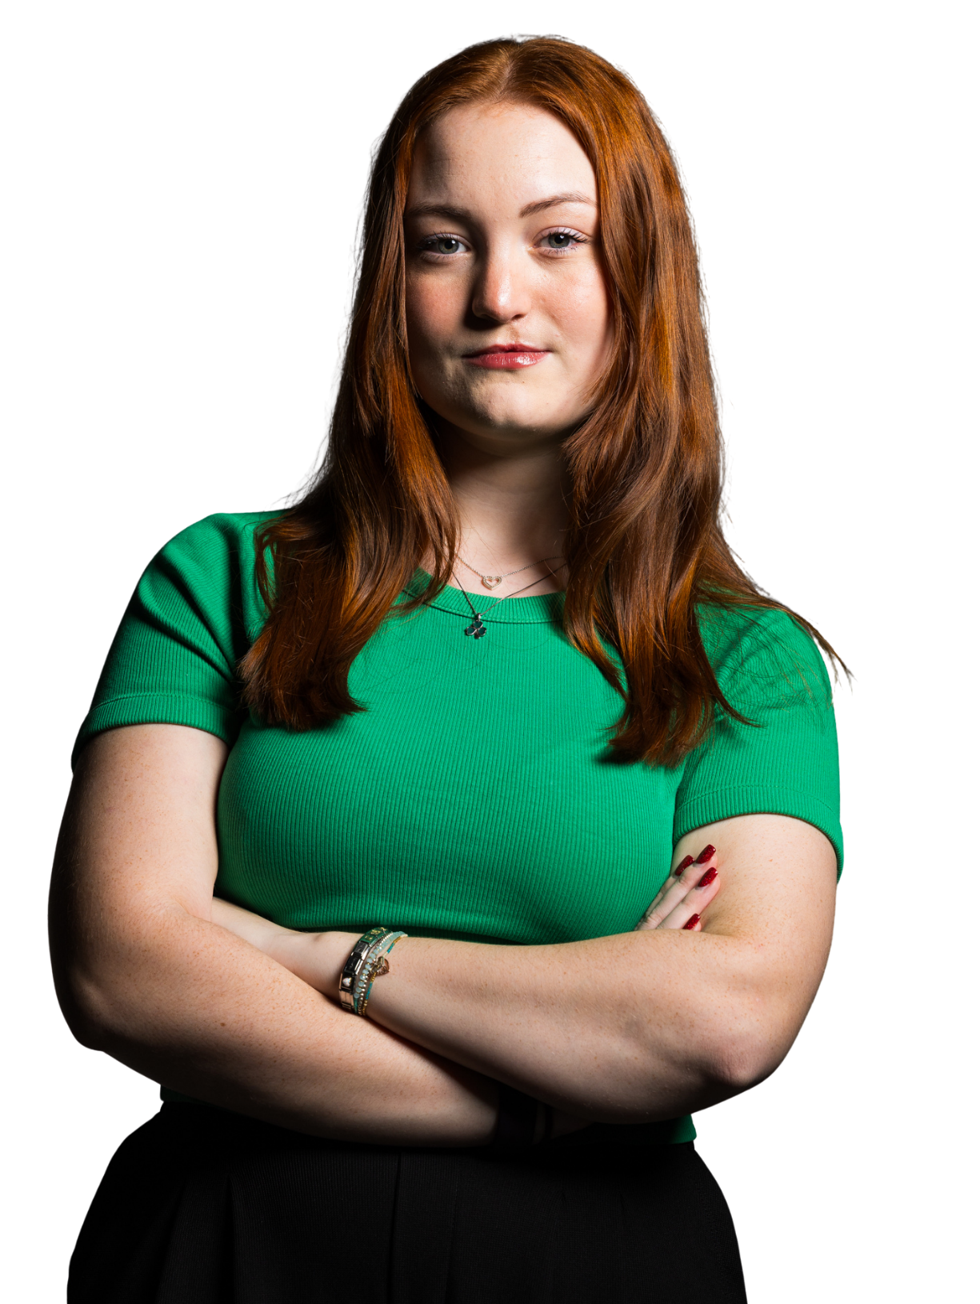
My Story
  Use this space to add the story of your cleft journey

Slide 11
How can you help?
  Spread the word on what you have found interesting today. Learn more about supporting people affected by cleft and our work at clapa.com
  Follow and share our social media – we are ‘@CLAPAcommunity’ on Instagram, Facebook, LinkedIn and TikTok.
  Being born with a cleft might make you different – but everyone is different! So please join us to celebrate these differences.

Slide 12
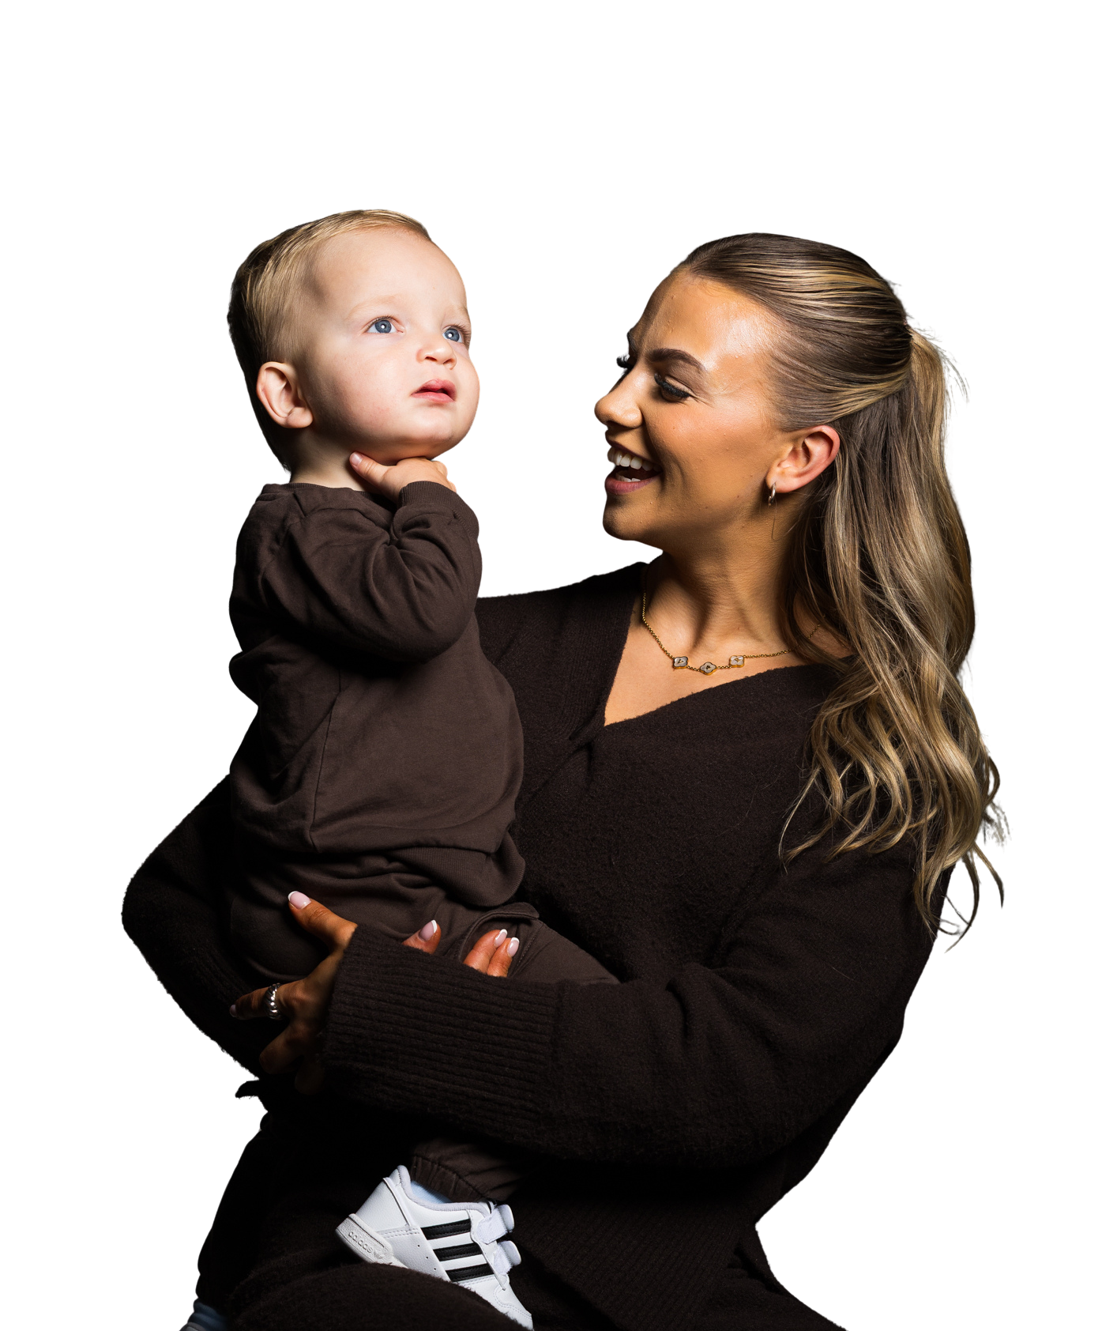
The difference you’ve made
  CLAPA has no government or NHS funding. We rely entirely on generous donations and fundraising from people like you to continue our work.​
  Your donations help to keep our services free and accessible to everyone who needs them.​
  ​In the past few years, you’ve helped us reach ​and support more people than ever!

Slide 13

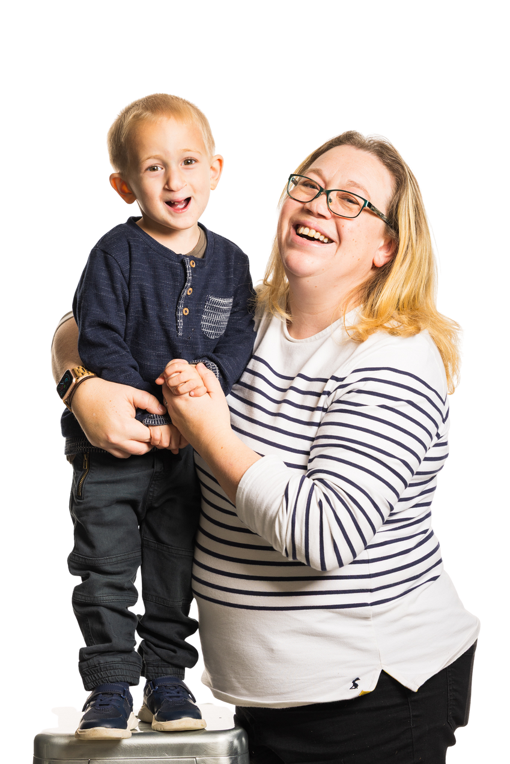

Registered Charity England & Wales (1108160) and Scotland (SC041034)

